Slide 1
The Power of Positive Gossip
June 28, 2023

Slide 2
Coffee & Conversations Agenda
8:00 Welcome to Coffee & Conversations: The Power of Positive Gossip, the second in our quarterly series
Brief summary on YWCA Northeast Indiana
The Tallest Poppy Syndrome
8:15 Cristina Jimenez is introduced
Understanding the ‘why’. Why do people feel the need to bring others down. Is it an attempt to feel better about themselves? Or, something else?
8:45 Tishamarie Strasser is introduced
How we can build others up
9:15 Wrap up
Thank you to our speakers and to Brotherhood Mutual!
Our next Coffee & Conversations event (Be a Forrest Gump: Refusing to Let Your Fears Stop You!) will be held on September 27th, at Ash Brokerage
Upcoming Circle event on October 19, 2023
Opportunity to support YWCA Northeast Indiana

Slide 4
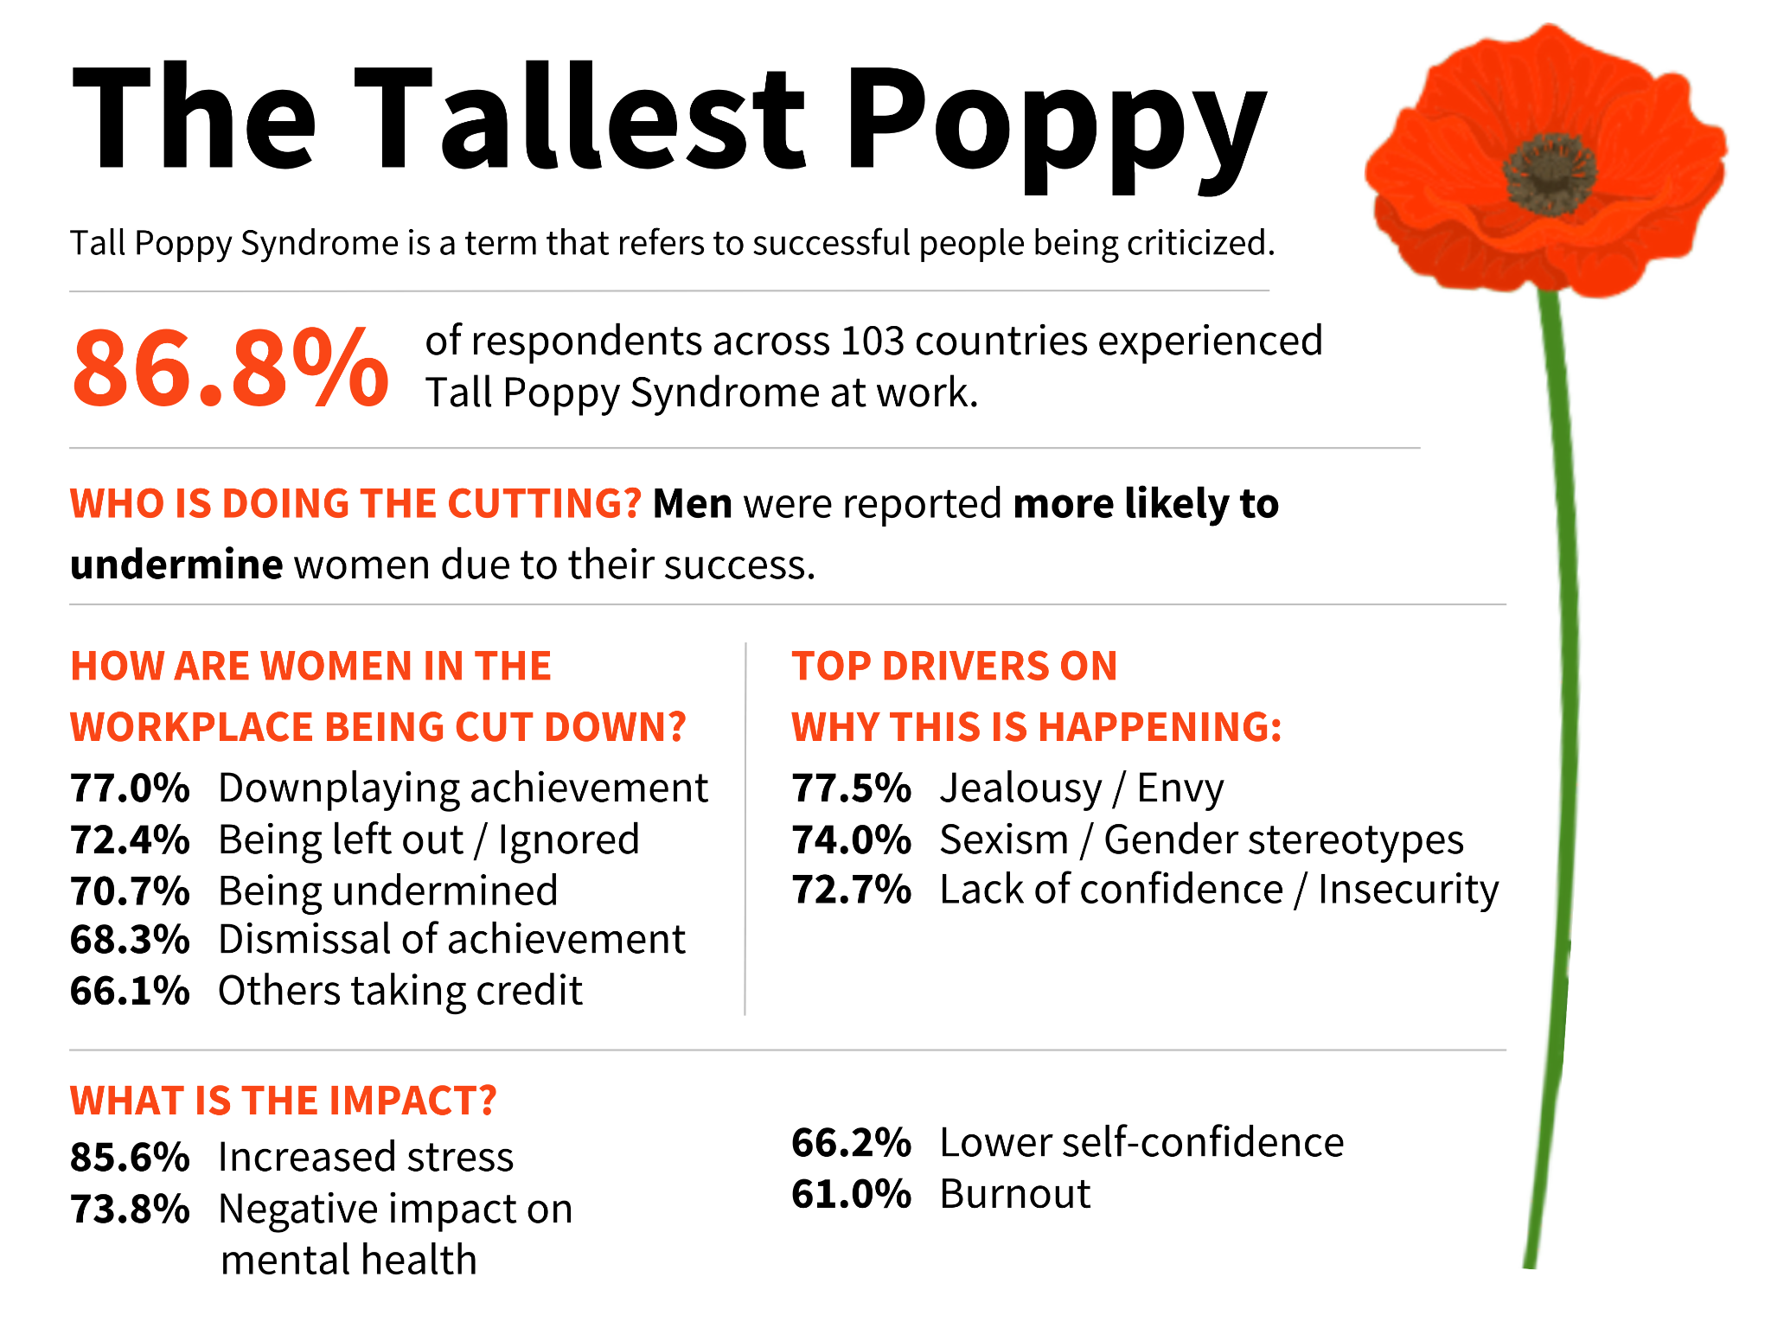

Slide 7
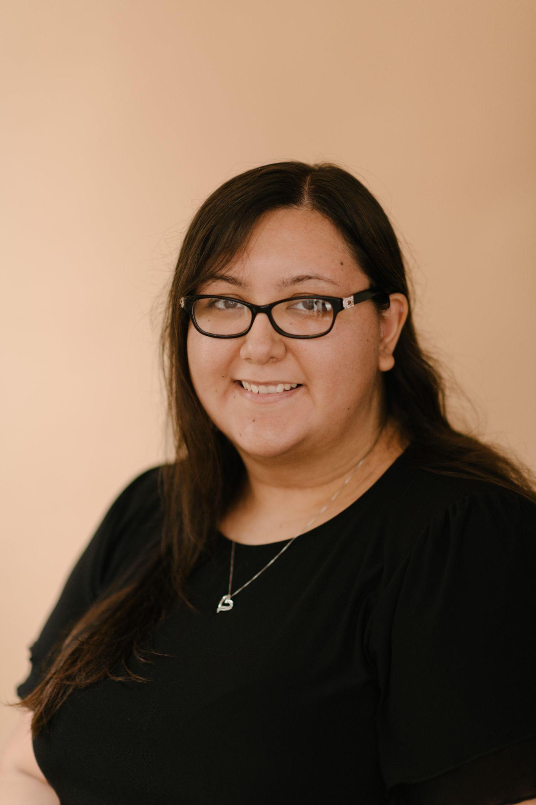
Speaker: Cristina Jiménez
Therapist, Courageous Healing
Cristina is a Therapist at Courageous Healing. She was born in California but raised on the southside of Fort Wayne, IN. Cristina graduated from Purdue Fort Wayne with a Master’s in Counseling Education. Her approach to therapy is using a culturally sensitive and trauma-informed lens to understand her clients and their experiences. She has had the opportunity to develop her skills and knowledge base while working alongside adults, teens, and the elderly in the social services field for about 5 years, with some of that spent working for YWCA Northeast Indiana as the Education Coordinator.
Cristina believes in empowering individuals, normalizing mental health and help seeking behaviors, and education. She has a passion for advocacy and for helping minority communities, particularly the Latino community. She is bilingual and uses her skills to support her clients and their families needs.

Slide 8
The Power
of Positive Gossip
Cristina Jimenez, M.S. Ed, LMHCA
Therapist at Courageous Healing Inc.

Slide 9
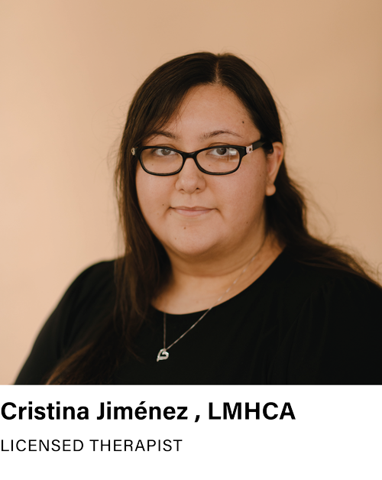
About The Presenter:
Trauma Informed and culturally aware Therapist at Courageous Healing
Experience working with individuals from the Latino community and various stressors unique to that community
Has worked with youth and teens individually and in group work
Trained in EMDR
Experience working with those who experienced Domestic Violence and Sexual Assault

Slide 10
Learning Objectives
WHY DO PEOPLE GOSSIP?
EMOTIONAL ADDICTION
EMOTIONAL IMMATURITY VS. MATURITY
IMPORTANCE OF SELF-AWARENESS
STRATEGIES FOR HEALTHIER RELATIONSHIPS

Slide 11
Like grooming done amongst primates, we use gossip as a means of bonding/closeness or conveying social info to a large social network.
Why Do People Gossip?
Evidence of cultural learning; provides examples of what is socially acceptable and what's not.
Form of entertainment
Staves off Loneliness
Intimacy or closeness is a prerequisite to gossiping
Helps people feel understood, validated, and seen

Slide 12
What Makes People Speak Poorly of Others?
They are accustomed to chaos or dysfunctional interpersonal patterns- “Drama”
It’s more comfortable talking about other people’s problems then our own
Projection of our own insecurities on others due to emotional immaturity

Slide 13
Emotional Addiction
When we are raised in homes that are chaotic, unpredictable, in cycles of crisis, our bodies can become dependent on stress hormones like adrenaline and cortisol
These high emotional states might have been the only time we got attention or connection

Slide 14
Feeling numb or bored unless there is stress or chaos
Relationships with unpredictable highs or lows (push pull dynamics)
Examples
of
Emotional Addiction
Cycles
Workaholism, over-committing, filling every moment of free time
The consuming and spreading of gossip
Using an activity or substance to numb that ultimately causes more stress or shame (shopping, gambling, etc.)

Slide 15
Self-Awareness of Interpersonal Patterns
Emotional Immaturity
Emotional Maturity
I can’t tolerate realities outside of my own
People’s actions are a reflection of who I am as a person
Boundaries are selfish and personal rejections
I have zero tolerance for anyone who disagrees with my beliefs
My relationships are spaces where I vent, gossip, and complain
Multiple realities can exist at once
People’s actions give me feedback around their space in my life
Boundaries are self care and personal limits
What people believe is based in their own perspective/worldview
My relationships are safe spaces of mutual sharing and expression.

Slide 16
Reflection
Questions
How do I react when I feel misunderstood?
When someone presents an opinion or interpretation of an event, I’ve experienced that different from my own, how do I react?
How often do I push my view as “right” or unconsciously seek to control an interaction?
As a child, when someone I loved denied, my reality how did it feel?
When I place a boundary and someone reacts negatively, how can I honor my need for self-compassion without letting that person cross the boundary?
What do I connect over in my relationships? How do I feel after connecting this way? (fulfilled, motivated, peaceful, drained, frustrated)

Slide 17
How to Emotionally Connect with Someone?
Open ended-questions that allow for connection as deep or surface level as is comfortable for the other person (people).
“What’s on your mind? (or heart)”
“What did you learn about yourself this past year?”
“When do you feel most yourself”
“How can I support you right now”
“How does that make you feel”
“What trait do you admire most in people? Why?”
“Where is the one place you feel most at peace?”
“What is important to you right now?”

Slide 18
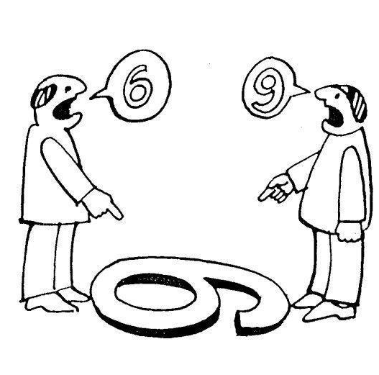
Empathy: A Tool for Connection
“Empathy is seeing with the eyes of another, listening with the ears of another and feeling with the heart of another.”
– Alfred Adler

Slide 19
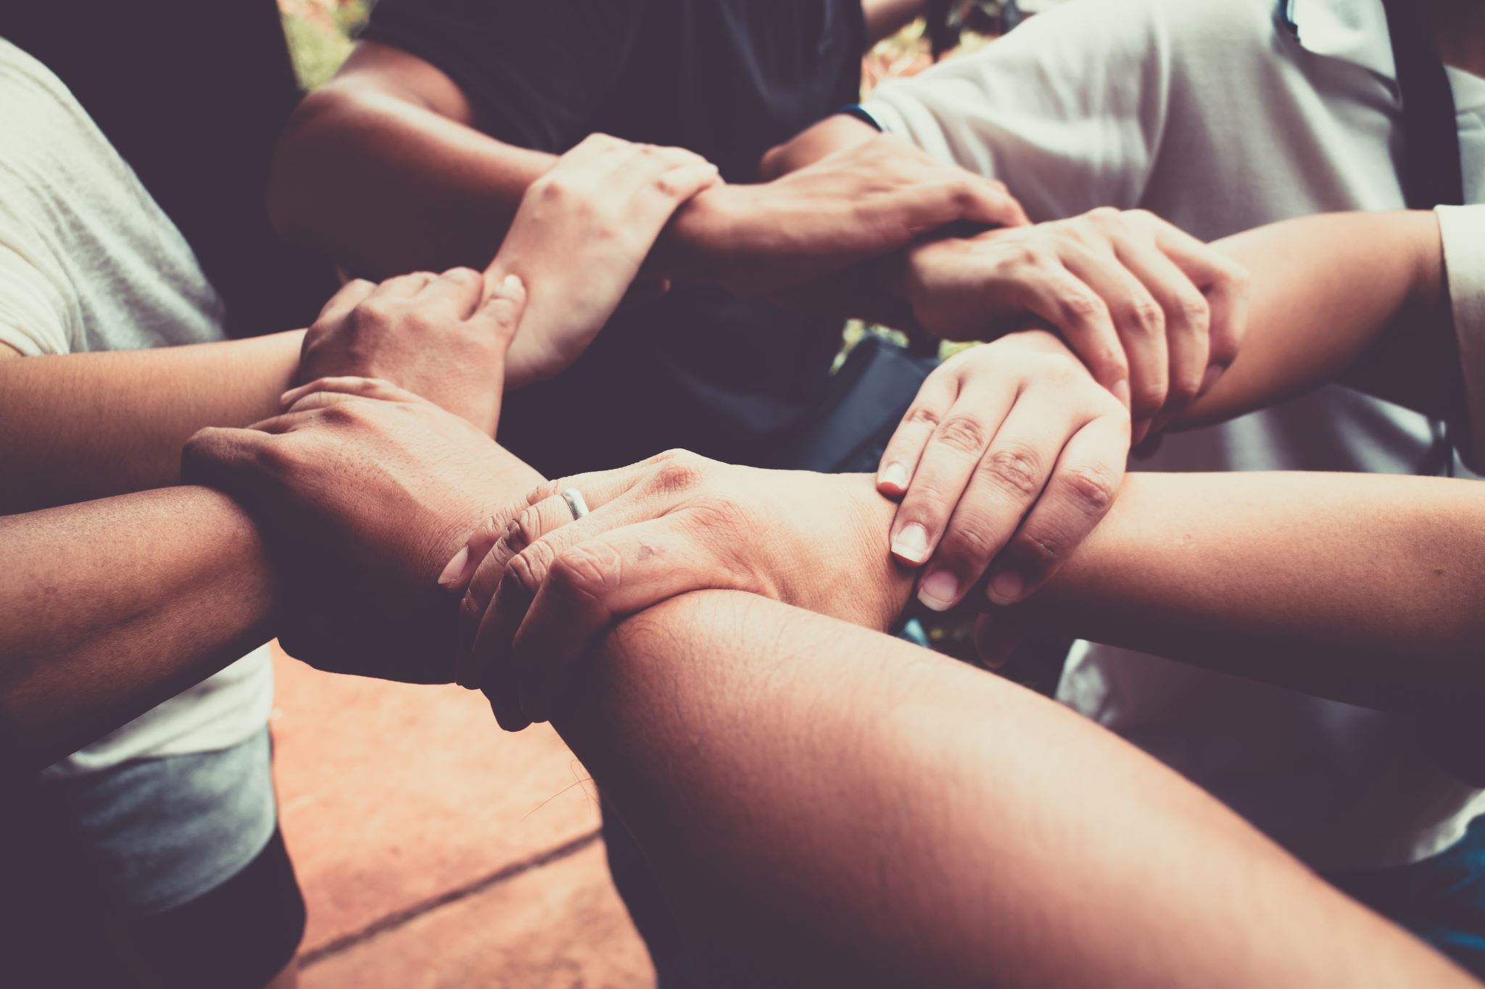
Strategies for an Emotionally Healthy Relationship
Appreciation: For Who they are rather than What they do.
Open Curiosity: Curiosity about their emotional state or internal world
Simple Connection: Intentionally making time to do things together
Energy Awareness: Awareness and consideration of their emotional state
Freedom To Be Self: Allow for authentic expression

Slide 20
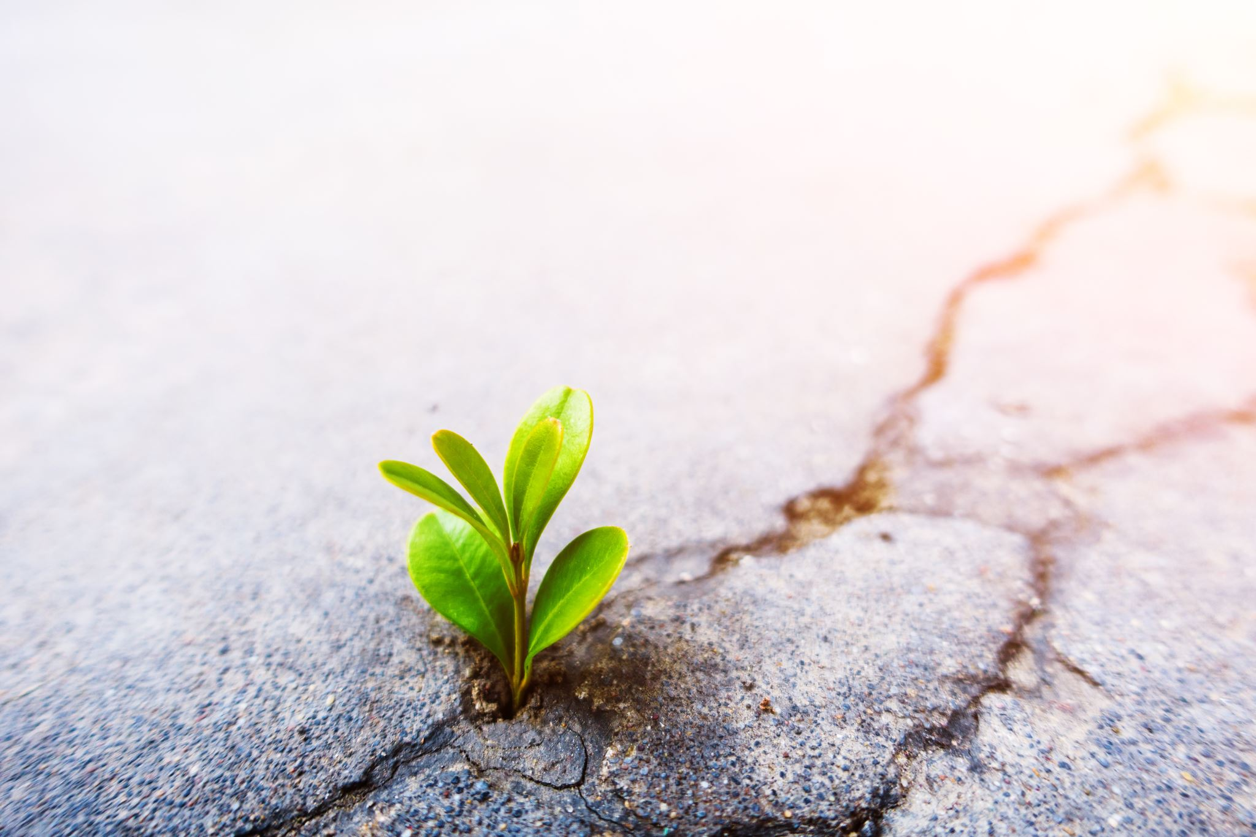
Gossip as a Unifier
Humans are social creatures
We thrive and heal in interpersonal relationships… and we also wound
Self-awareness, growth, and gossip as a tool for positive connection

Slide 21
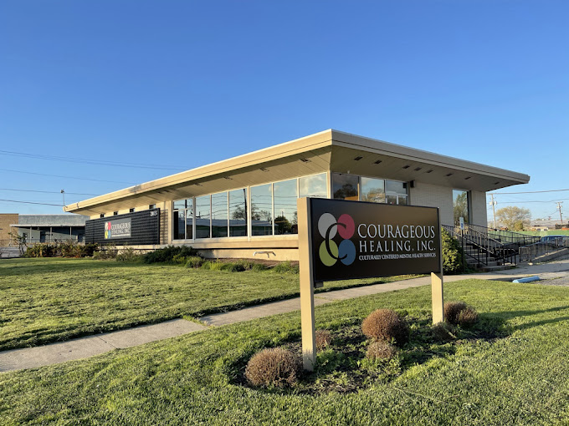
Thank
you!
CRISTINA JIMENEZ
CRISTINA@COURAGEOUSHEALING.ORG
2013 SOUTH ANTHONY BOULEVARD FORT WAYNE, IN 46803
260-255-3514
HTTPS://WWW.COURAGEOUSHEALING.ORG

Slide 22
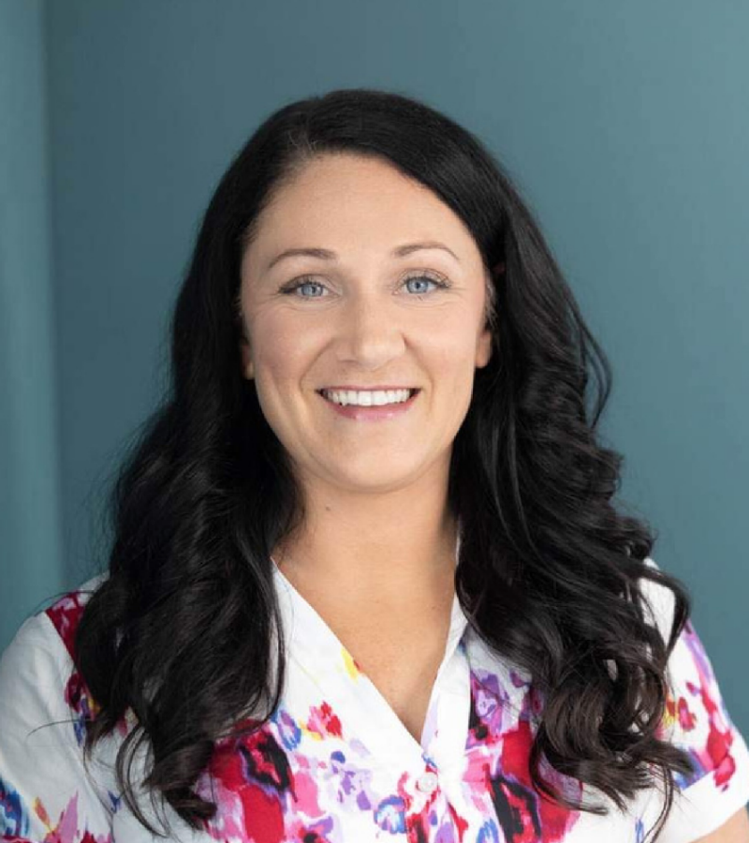
Speaker: Tishamarie Strasser
Founder: Bring It, Push It, Own It
Tishamarie (statistic turned CEO of "Bring It, Push It, Own It") tells her story of how she stopped being the victim and became her own hero. She has 10 years of experience that includes starting a non profit that helps girls, women, the disability community, and athletes discover their true passion, power, and purpose. She now helps others step out of their own story and discover how to be their own heroes. Using her mentoring, Neuroencoding certification, and lived experience, Tishamarie is here to get you off of your roundabout and ready to rise up and be your own hero!
Turning a life of trauma, chronic illness and pain into a purpose driven life filled with passion and joy.

Slide 23
Thank you to our speakers!
Thank you to our event sponsor:

Slide 24
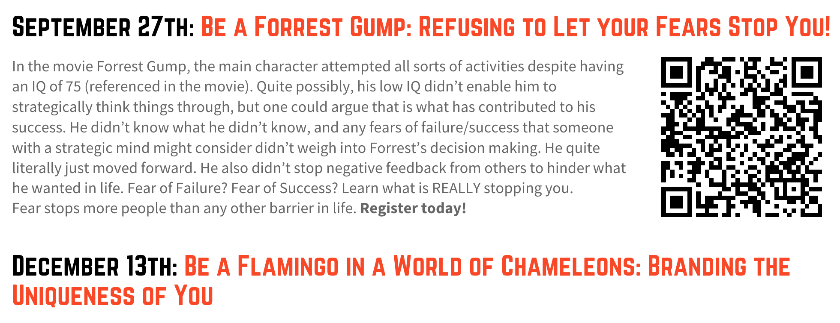
Save the date for our upcoming
Coffee & Conversation events!
ywcanein.org/coffee-conversations

Slide 25
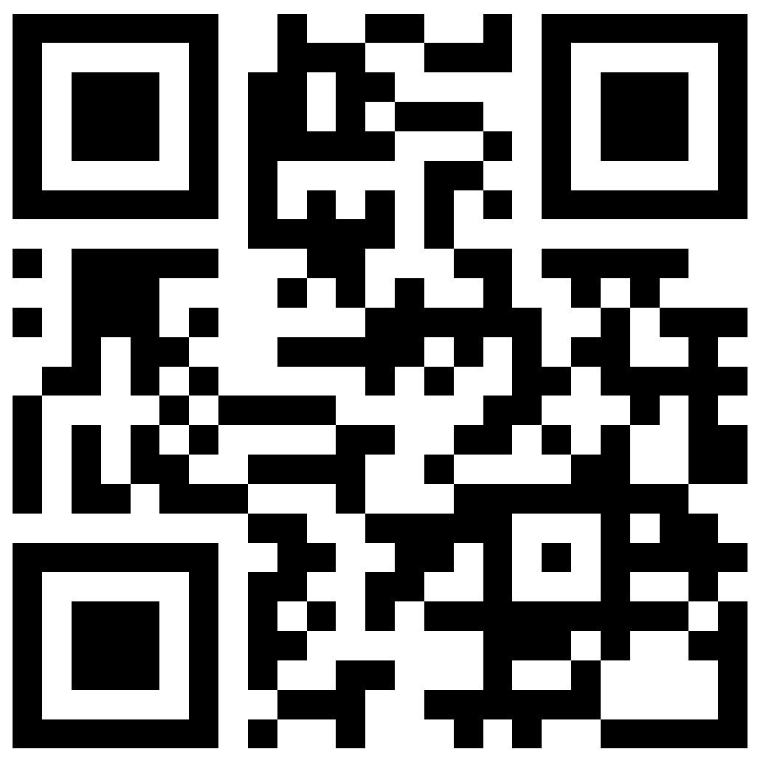
Register now for our 27th annual
Circle event
October 19th
11:30 am - 1:00 pm
Ceruti’s Catering
ywcanein.org/circle

Slide 26
Changing the World, One Message at a Time
There is power in words. You have the power to make someone else’s day special by giving them this card.
At the same time, you have an opportunity to make the lives of the clients we serve better with a donation.
For $5, you can receive one of the cards to give to someone. For $20, you can receive a bundle of 5 cards.

Slide 27
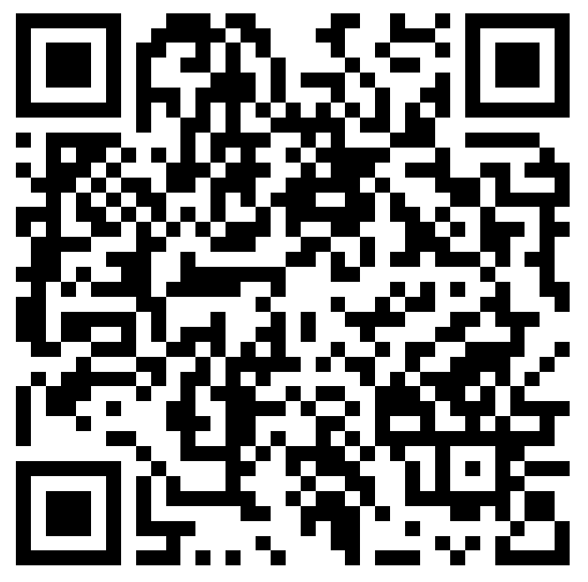
Please donate to support our work!
YWCA Northeast Indiana is a nonprofit organization, funded by generous donors like you. Donations fund our life-changing programs as well as our community events so that we are able to offer these for free. Please consider a gift today. Every dollar matters.

